Slide 1

AI-Driven Analysis of Pilgrim Experiences: Enhancing Hajj and Umrah Services Through Smart Data Insights

Slide 2
Abstract
The Hajj and Umrah pilgrimage sectors struggle to process and extract valuable insights from the vast amount of feedback they receive—around 30 million comments each year in more than 27 languages. The high volume and linguistic diversity of these reviews make it challenging for authorities to sort and address recurring concerns systematically.
This project aims to introduce an AI-powered solution using pre-trained transformer models, such as GPT, to analyze pilgrim feedback efficiently. The system will categorize comments into key service areas, including immigration, accommodation, transportation, and public services, while also assessing sentiment to determine overall satisfaction levels.
Furthermore, the AI model’s performance will be measured using accuracy, precision, recall, and F1-score metrics to ensure its reliability. By adopting this approach, authorities can obtain data-driven insights to enhance the pilgrimage experience, improve service quality, and make more informed decisions.

Slide 3
Introduction
Overview: Hajj and Umrah relies on millions of data to enhance customer service
Problem Statement:
The Hajj and Umrah pilgrimage receive—around 2-3 million comments each year
The comments are projected to reach 30 million comments by 2030, in more than 27 languages.
Hajj and Umrah are facing challenges using traditional methods to analyze the data
Proposal: This project proposes an artificial intelligence system to enhance customer service analysis at Hajj and Umrah
Significance : The system provide timely, accurate, real-time, complete, relevant, and precise big data analysis

Slide 4
Project objectives
The proposed project aims to develop an AI-powered analytics system capable of processing and categorizing large-scale pilgrim feedback data. The primary objective is to leverage Natural Language Processing (NLP) and pre-trained transformer models to analyze text-based reviews and identify key areas that require service enhancements.
Other objectives include:
To use pre-trained transformer models to analyze pilgrim feedback efficiently
To generate visual representations to enhance data-driven insights and decision-making.
To provide a confidence interval against each comment analyzed. The confidence interval builds into the credibility and accuracy of the text classified and sentiment analyzed, helping service agents and analysts make informed choices and decisions.

Slide 5
Beneficiaries
Pilgrims – Improved services based on data-driven enhancements will lead to a more seamless and satisfactory pilgrimage experience.
Ministry of Hajj and Umrah – Access to AI-generated insights will allow for informed decision-making and targeted service improvements.
Service Providers – Hotels, transportation companies, and healthcare services can refine their offerings based on real-time feedback analysis.
AI & Data Science Researchers – The project will provide a case study on applying AI to large-scale multilingual sentiment and topic classification.
By adopting this approach, authorities can obtain data-driven insights to enhance the pilgrimage experience, improve service quality, and make more informed decisions.

Slide 6
Research Questions
How can pre-trained transformer models, like GPT, analyze reviews from pilgrims to identify the main challenges they face?
How accurately can AI models classify pilgrims' comments as positive or negative?
What are the most common challenges pilgrims face based on AI-driven sentiment analysis, and which service areas require improvement?
How do the findings from AI-based analyses compare with previous studies regarding model accuracy?

Slide 7
Structural Design and Architecture:
Home Page
A demographic and cross-demographic
Documentation
Text and Sentimental Classification Analysis
Age Distribution Analysis
Statistical overview
Nationality and Gender Analysis
Cross-Demographic Distribution
Gender and Language Analysis
Statistical Distribution and Descriptions with interpretations
Users read the manuals to understand how to use and navigate through the system
Input textual, API, URL, or file data for sentimental and textual analysis
Service Categorization

Slide 8
Terminologies
Customer service analysis, CSA: The use of statistical methods or models to extract valuable insights from statistical data retrieved from customer feedback and sentiments (Kaplan, 2020).
Statistical methods: A group of processes and methods for collecting, organizing, analyzing, and interpreting data to make informed decisions or understand a phenomenon (Amanah et al., 2021).
Data: information in the form of facts or numbers (Bohn, 2018).
Big Data: A massive data generated at high velocity, and is highly diverse, valuable, and possesses big veracity (Putri & Puteri, 2024).
GPT refers to Generative Pre-trained Transformer (Almutaibi, 2024)
DistillBERT and BERT refers to Bidirectional Encoder Representations from Transformers (Almutaibi, 2024)
Accuracy: Overall correctness (Bohn, 2018).
Precision: Proportion of accurate positive predictions (Almutaibi, 2024)
Recall: Proportion of accurate predictions (Almutaibi, 2024)
F1-Score: precision and recall harmonic mean (Bohn, 2018).
Confusion Matrix: Summarized evaluation performance of classification model (Almutaibi, 2024)

Slide 9
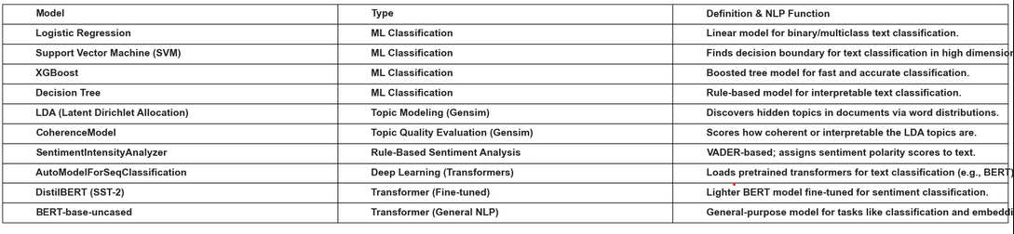
Trained models in this project

Slide 10
Literature Review
Digital technology and customer service analysis
Digital technology is effective in improving customer experience
Digital technology can be used in Hajj and Umrah
It improves credibility, promote visitor engagement, leverage on perception, and build on trust
Ahmadi and Sudahri (2025) and Firdos and Dermawan (2023)
Benefits of Improving Customer Service
Improve worship experience
Enhance customer comfort
Facilitate achievement of vision 2030 at Hajj and Umrah
Subhan et al. (2023)
Natural Language Processing and Pretrained Models
Pretrained models are effective in natural language processing tasks
traditional models are poor in analyzing multilingual textual data
Almutaibi (2024) and Salıcı & Ölçer (2024)

Slide 11
Research Gaps
Gaps
Previous studies are purely theoretical
Little practical project exists to validate findings
Studies overlooked the use of complex multilingual data like Umrah and Hajj data from Saudi Arabia
Studies used SmartPLS3.2.9 and SEM-PLS applications and not pretrained transformers
Studies fall short in real-time sentiment analysis and text classification of pilgrimage comments and feedback
Implication of this study
This study and the system developed bridge current gaps in research by introducing an NLP deep learning and transformer text classification and sentiment analysis AI-powered driven system, classifying and analyzing real-time, multi-lingual comments.

Slide 12
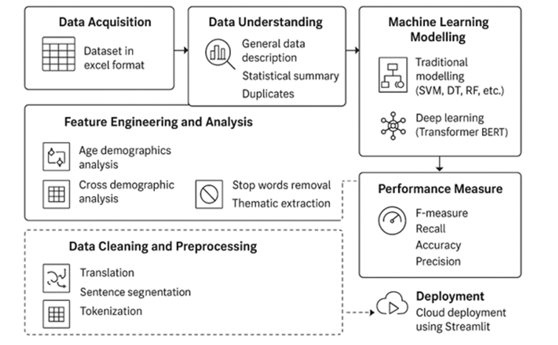
Overview: Project Methodology

Slide 13
Datasets/Data Collection
Dataset Used: Comments and Feedback from Pilgrimages
Data Collection: From the Ministry of Hajj and Umrah database
Source : https://www.haj.gov.sa/Home

Slide 14
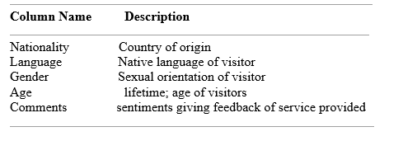
Data Description
10500 observations (rows) and 5 columns (variables
All columns are categorical except Age which contains numerical data
Data is 410.3+ KB in usage, good for CPU use
Names of columns and description

Slide 15
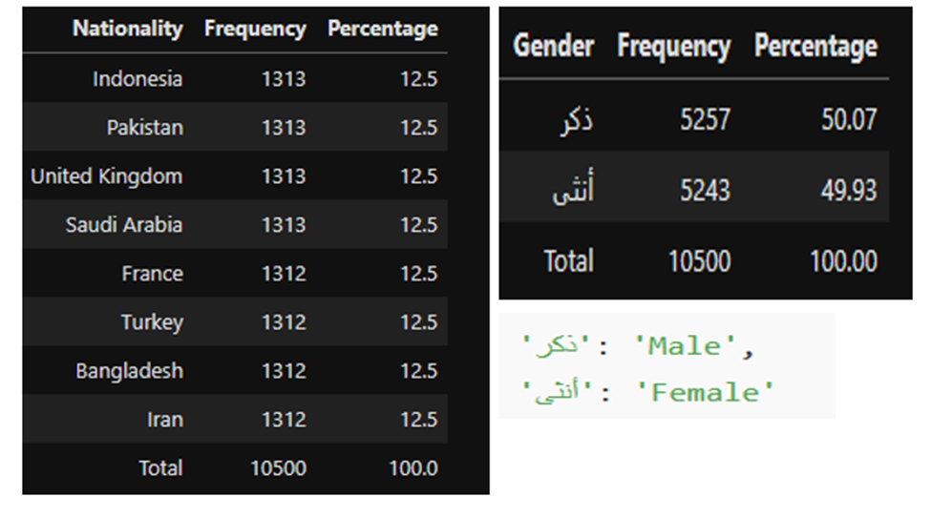
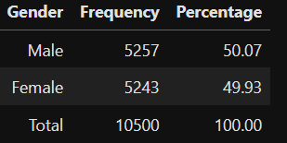
Data Understanding: Statistical Description Formulas are displayed in the Appendix
Frequency Distribution Tables
From left to Right: TABLE 4 showing the frequency distribution table of the Nationality variable and TABLE 5 showing the frequency distribution table for the Gender variable.

Slide 16
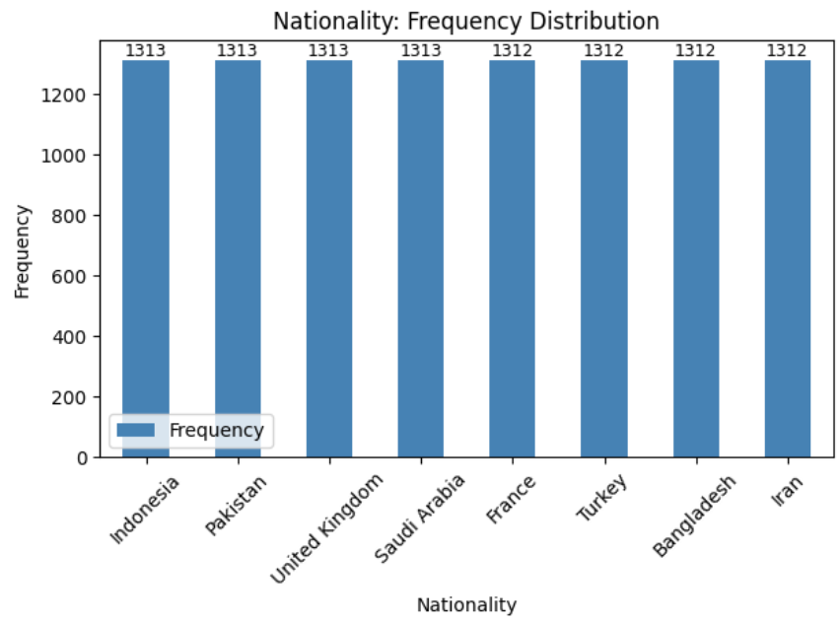
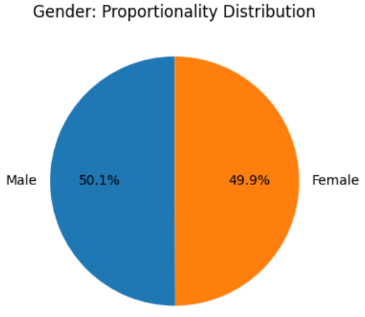
Data Distribution: Variation and Spread
Graph 3, left, shows the frequency distribution of Nationality, and Graph 4, right, shows the Gender proportionality and distribution in the dataset.

Slide 17
Interpretations of Data Distribution National and Gender Variables
Distributions of nationality data symmetrical and lacks skewness
Nationality variable lacks variability
Comments are free of nationality biases
Proportionality of the male and female individuals was equally similar
The gender variable shows that the comments are free of gender bias, because both genders are equally represented in the sampled comments
The comments are credible for use in this project

Slide 18
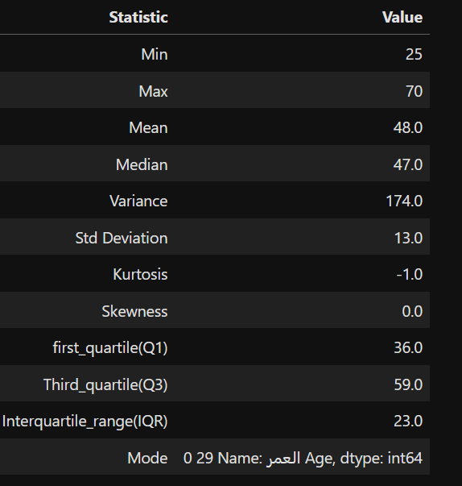
Data Description: Age Variable
Statistical Summary
The least age of individuals sampled was 25 years
The maximum 70 years, giving a range of 45 years
Most individuals are evenly clustered around 48 years
The most frequent age is 29 years.
The slight variations in the mean, median, and mode age suggest slight variations in the dataset
This variation is supported by a standard deviation of 13.0, confirming that the ages of individuals are dispersed in the dataset.

Slide 19
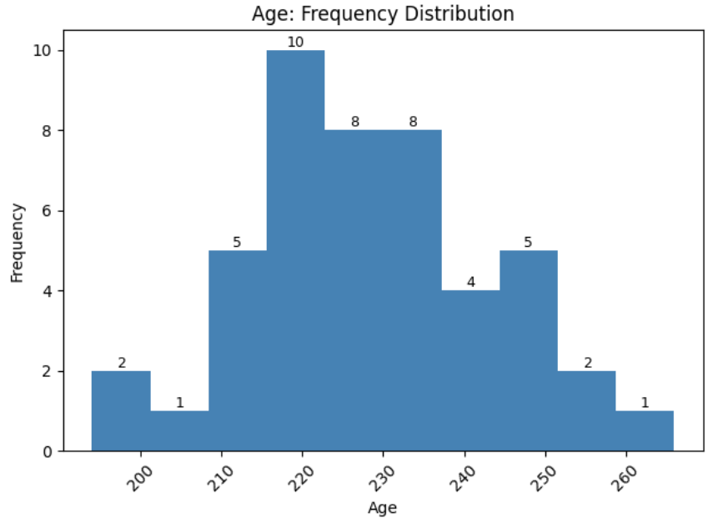
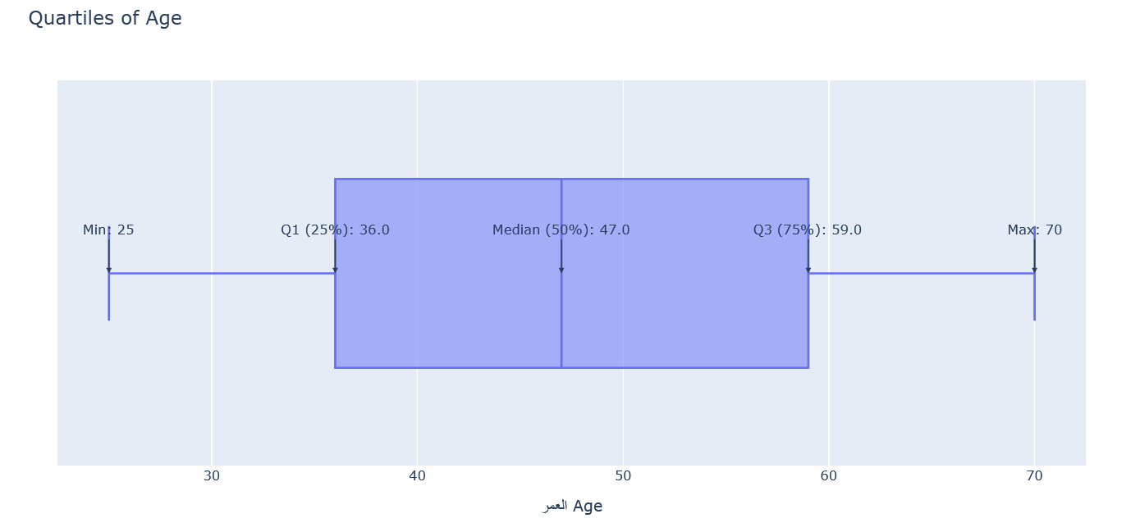
Age Data Distribution
Left, Graph 5 showing symmetrical age distribution of ages, and Right, Graph 6 showing a boxplot representing the age distribution of the age variation about the quartiles

Slide 20
Interpretation of Age Distribution
Age distribution is almost symmetrical, and the skewness is equal to zero
Individual ages are evenly distributed about the mean, lack skewness, and are evenly clustered near the median
Comments are fairly represented individuals visiting the pilgrimage of ages 14-70
The peak of the age distribution is flat or platykurtic
The comments are credibility use in this project, for they are bias-free of individuals' age.

Slide 21
Data Mining/Cleaning/Preprocessing
Translation
Conversation of different languages into English to enhance preprocessing of the data
Using deep translator from Google Translator
Normalization:
Long sentence comments segmentation to enhance readability, capitalization, and punctuation
Using segmenter from nltk
Tokenization:
Sentence comments segmentation to fundamental units; words, tokens
Using word_tokenizer from nltk
Lemmatization
converting textual data into its basic form, mostly dictionary form
Using en_core_web_sm pipeline from Spacy

Slide 22
Data Mining/Cleaning/Preprocessing
Parts of Speech Tagging
Labeling words in a text into their basic linguistics parts
Enhances data comprehension and machine learning modelling
Done using using en_core_web_sm from spacy library.
Stop word removal:
Removing common and useless words
It enhances language clarity and reduce noise in data
Done using stop_words from nltk corpus
Vectorization
Conversation of categorical data to numerical data
done using TfidfVectorizer (TF-IDF) from sklearn
Thematic extraction:
Generating service categories from comments
done using Coherence Model and LdaModel from genism
Feature Engineering and Transformation:
Variables isolation into a new dataset with demographic variables

Slide 23
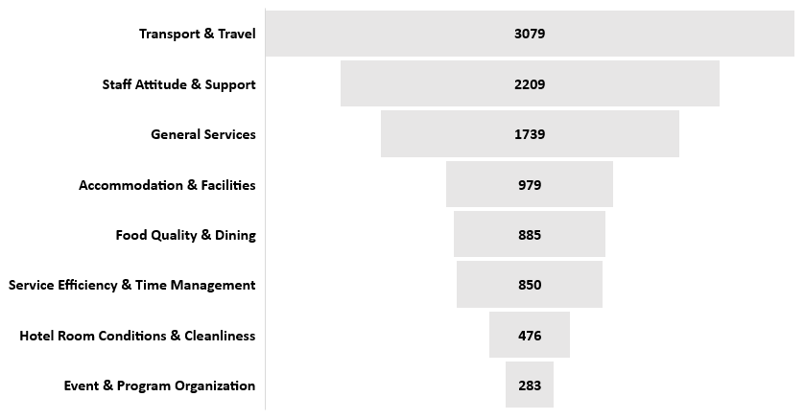
Themes Extracted from TF-IDF Output Terms
Service Categories: Themes and Departments

Slide 24
Feature Engineering and Analysis
Feature engineering isolated variables and generated a new dataset with the variables of interest.
It enhanced the analysis of demographics and cross-demographic data.
It helped built demographic and cross-demographic dashboard
The characteristics of age, nationality, language, and gender were isolated and visualized using interactive plotly graphs, as shown in the following subplots.

Slide 25
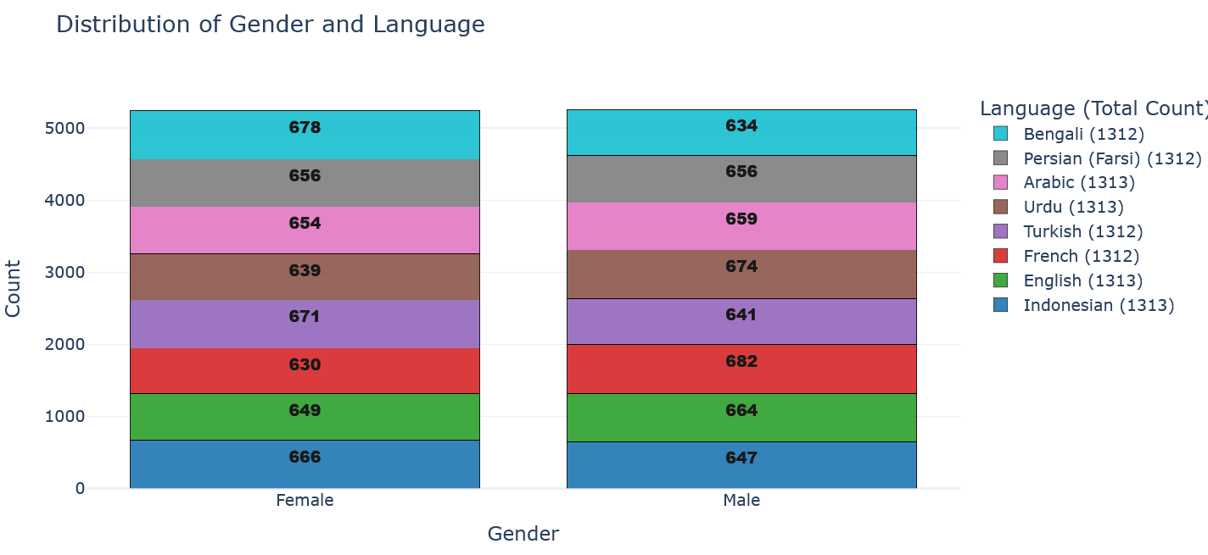
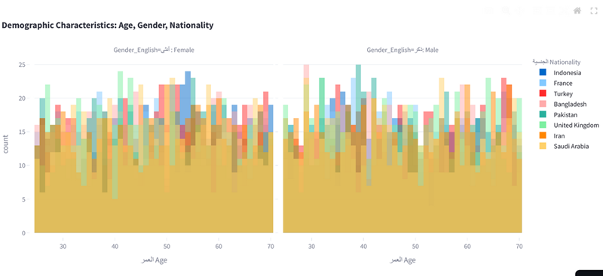
Some of the Visualizations from Feature Engineering
These subplots, and some not shown, builds the demographic and cross-demographic dashboard analysis

Slide 26
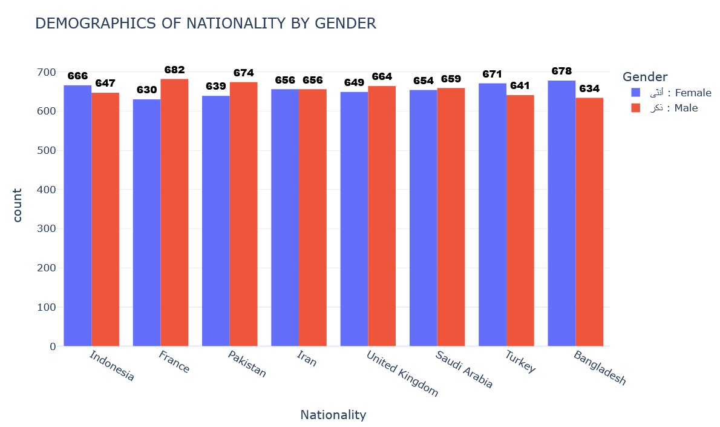
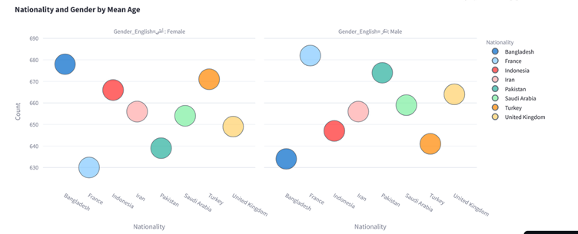
These subplots, and some not shown, builds the demographic and cross-demographic dashboard analysis

Slide 27
Models used and Evaluation Techniques
Machine Learning Classification Models:
Traditional models: Logistics Regression, Support Vector Machine (SVM),
XGBoost, and Decision Tree
Thematic Extraction Models
Gensim Models
LDA, Latent Dirichlet Allocation
CoherenceModel
Sentiment Analysis and Classification Models Deep Learning Models:
Sentiment Intensity Analyzer
AutomodelForSequenceClassifications
Distilbert-base-uncased-finetuned-sst-2-English
Bert-base-uncased
Comparison Metrics
Evaluation of performance using Precision, Recall, F1-score, Confusion matrix, and Accuracy scores

Slide 28
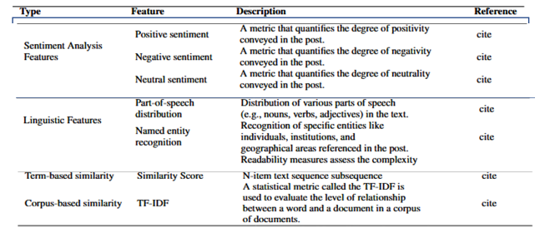
Features Used for Modelling and Analysis
The following features were used for analysis and modelling borrowed from studies by Subhan et al. (2023), Ahmadi and Sudahri (2025), and Firdos and Dermawan (2023)

Slide 29
Summary: Statistics and Visualizations used
Tables: statistical summary of the dataset and frequency distributions
Line graph showing Age demographic analysis with statistical markers
Interactive line graph showing age distribution
Bubble maps showing nationality and gender by mean age
Histogram showing demographics of nationality by gender
Interactive histogram showing demographic characteristics of age, gender, and nationality
Scatter plot showing distribution of confidence of sentimental analysis
Bar graph showing negative sentiments per department and service category
Stacked Bar plot showing demographics of gender and language
Pie Chart showing proportionality of gender distribution

Slide 30
Summary: Main Tools Used in the Project Environment Configuration and Tech Stacks
________________________________________
FUNCTIONS MAIN TOOLS
________________________________________
Programming Language Python 3.10
Data Processing Scikit-Learn, Pandas, Numpy,
Visualization Seaborn, Matplotlib, Plotly
Machine Learning Scikit-Learn
Deep Learning Hugging Face Transformer
Model Evaluation scikit-Learn, Torch
Text Analysis and Translation Nltk, Deep Translator, Gensim, Collections
Deployment Streamlit Cloud Community
Collaboration Git Bash and Git Hub
Further Analysis Pivotal Table in Excel Spreadsheet
________________________________________

Slide 31
Results
This section explores the findings of the study and project focusing on the following areas which address the research questions and objectives of the project
Summary Of Model Evaluation Performance Metrics
Text Classification And Sentimental Analysis Of The Model
Visual of Confidence Distribution Showing Accuracy Of Model In Classification And Analysis
Bar Graph of Sentiment Distribution and Service Categories
Theoretical Analysis of the Correlation Between Previous Studies (Expert Analysis) and Model Accuracy

Slide 32
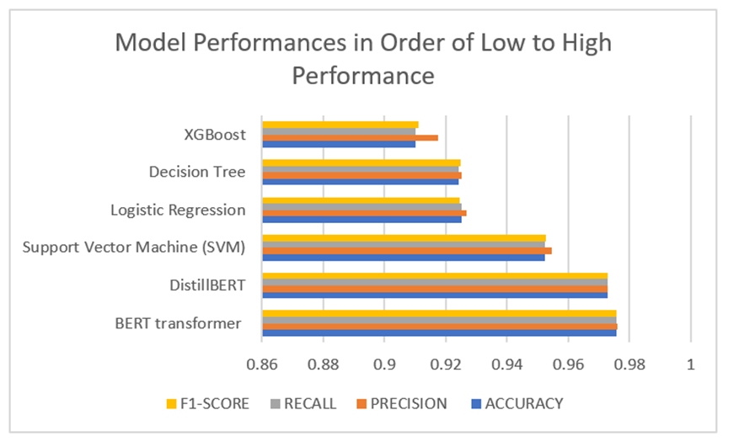
Results: Model Performances
Performance of Model from lowest to higheest
XGBoost
Decision Tree
Logistic Regression
SVM
DistillBERT transformer
BERT Transformer
Model performance results in ascending order

Slide 33
A Comprehensive Result of the Model’s Accuracy, Precision, Recall, and F1-score in Percentage
MODEL | ACCURACY | PRECISION | RECALL | F1-SCORE
XGBoost | 91.00 | 91.75 | 91.00 | 91.12
Decision Tree | 92.42 | 92.52 | 92.43 | 92.47
Logistic Regression | 92.52 | 92.69 | 92.52 | 92.45
(SVM) Support Vector Machine | 95.24 | 95.45 | 95.24 | 95.27
DistillBERT | 97.29 | 97.28 | 97.29 | 97.28
BERT transformer | 97.58 | 97.60 | 97.57 | 97.58

Slide 34
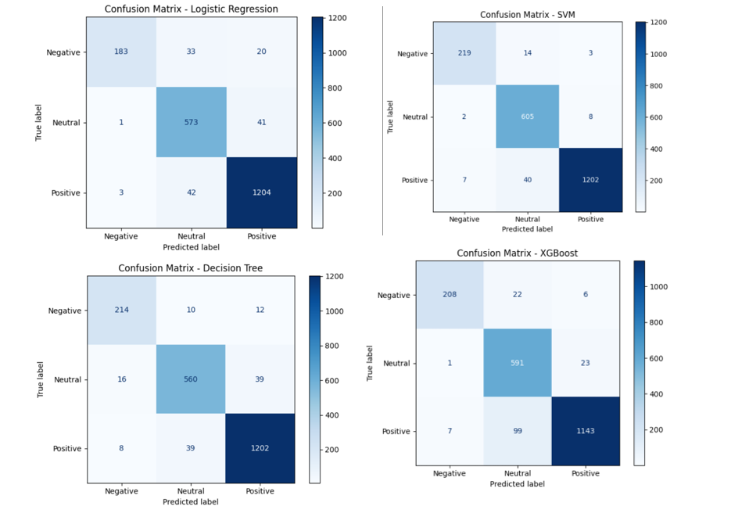
Confusion Matrix of The Models
The confusion matrices shows the number of predicted values against actual values of:
Positive sentiments (Dark blue)
Negative sentiment (Light blue)
Neutral sentiments (Faint blue)

Slide 35
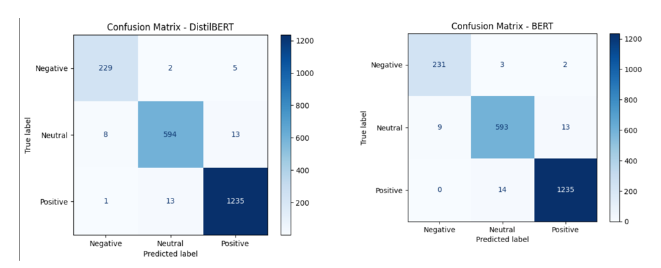
The confusion matrices shows the number of predicted values against actual values of:
Positive sentiments (Dark blue)
Negative sentiment (Light blue)
Neutral sentiments (Faint blue)

Slide 36
Interpretation of Model Performance
All models at least scored 90% in performance
BERT and DistillBERT performed the highest, with BERT leading in performance with a 97.58% accuracy
POS and Lemmatization increased performance of models
Exceptionalism in performance is seen in XGBoost and SVM
XGBoost performed poorly compared to SVM
XGBoost works well with large datasets characterized by heavy feature engineering and multiple structured variables
SVM performs best with a small dataset and easily interpretable data.
Other models performed as expected:
Logistic regression and decision tree are naïve hence the low performance
BERT and DistillBERT are pretrained transformers best for sentimental analysis and classification
BERT is built upon DistillBERT hence the highest performance of BERT model

Slide 37
DistilledBERT versus BERT Models Performance
The models are bidirectional and learns contextually
But BERT performed better than DistillBERT
BERT builds upon DistillBERT transformer with more enhanced features:
Handling complex large dataset
Reduced computational cost
Improved dependency
Effective in NLP tasks

Slide 38
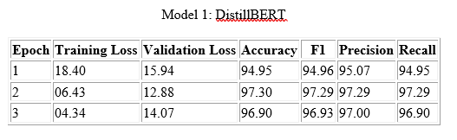
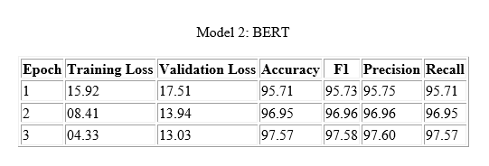
Optimal Performance by Epoch
DistillBert performed best at epoch 2
Bert-base performed best at epoch 3
Bert had an accuracy of 97.57% at epoch 3
The Bert-base model was selected for deployment using Streamlit
Bert had best performance, efficiency in class balancing, and interpretability.

Slide 39
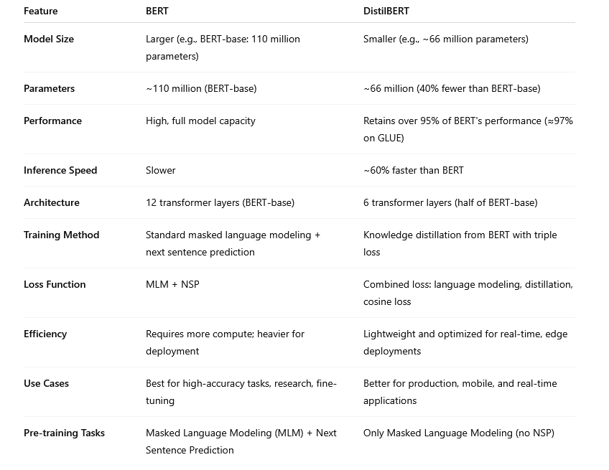
Difference between BERT and DistillBERT

Slide 40
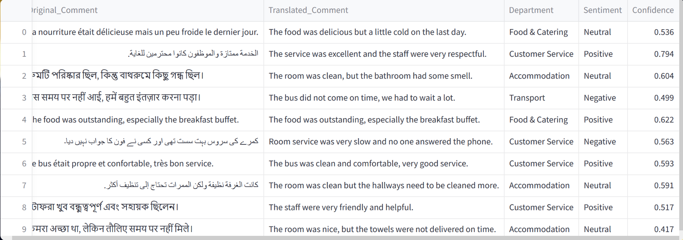
Sample Output of BERT Model Sentimental Analysis and Text Classification
The output from the platform demonstrated pre-trained transformer models, like BERT, can analyze reviews from pilgrims, classify comments into service categories, and analyze the comments to identify the main challenges they face

Slide 41
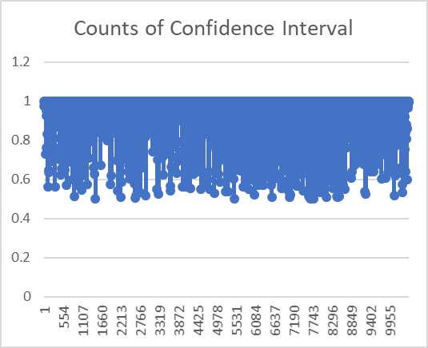
Left: Counts of Model Confidence in Text Analysis and Classification, confidence is clustered around 90-100 percent.
The results show AI models can accurately classify pilgrims' comments as positive or negative.

Slide 42
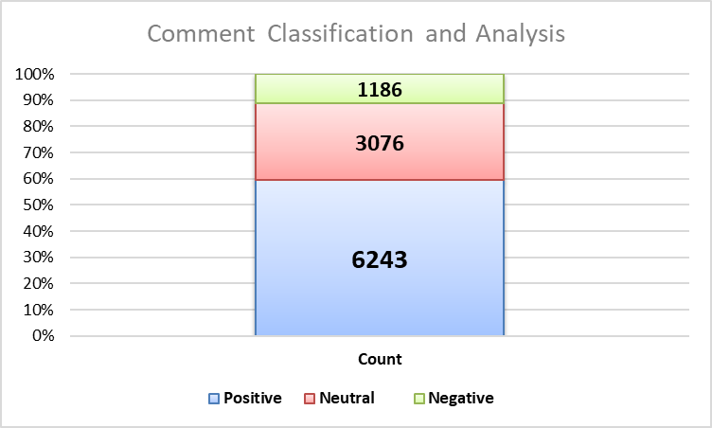
Graphs: Counts of Sentiments By Classification Analysis, Pilgrims Experience is Mostly Positive.
The model shows that most sentiments are positive, followed by neutral sentiments, and negative sentiments. The classification and analysis demonstrate that AI-powered models can potentially enhance customer service analysis in the Hajj and Umrah pilgrimages

Slide 43
Comparative Analysis of Counts Per Department
The model shows that most sentiments are positive, followed by neutral sentiments, and negative sentiments. The classification and analysis demonstrate that AI-powered models can potentially enhance customer service analysis in the Hajj and Umrah pilgrimages

Slide 44
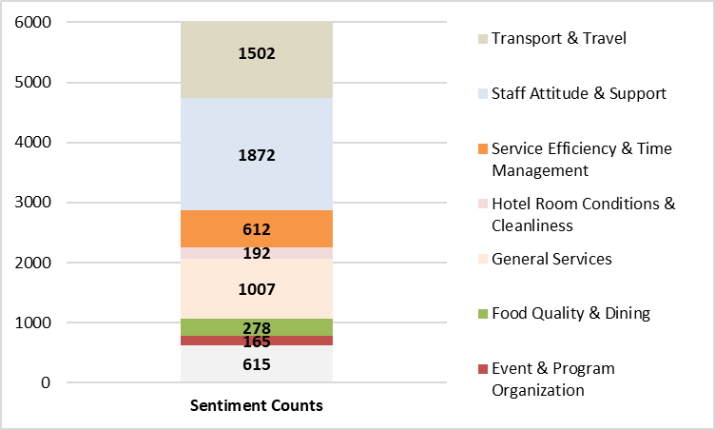
Comparative Analysis of Positive Counts Per Department
Graph shows customers express high levels to low levels of satisfaction in the order of transport and travel, staff attitude and support, general services, service efficiency and time management, food quality and dining, event and program organization, and hotel room conditions and cleanliness.

Slide 45
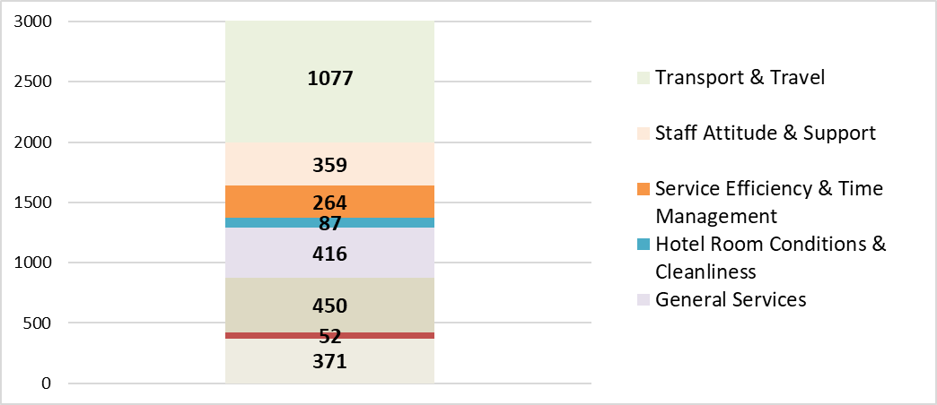
Comparative Analysis of Neutral Counts Per Department
Customers provided neutral sentiments in the following department and services, in the order of high to low

Slide 46
Comparative Analysis of Negative Counts Per Department
In regards to the negative sentiment, event and program organization, service efficiency and time management, transport and travel, and staff attitude and support had the most negative sentiments.

Slide 47
Comparison Analysis: My Studies and Previous Studies
Authors and Year | Title of Publication
Subhan, A., Firdaus, A. F., & Najib, M. (2023) | The influence of Islamic service quality and trust on customer satisfaction and intention in reusing the services
Shah, A. A. (2024). | Enhancing Hajj and Umrah rituals and crowd management through AI technologies: A comprehensive survey of applications and future directions.
Chelloug, S. A., Muthanna, M. S., Jamil, F., Al-Gaashani, M. S., Alhelaly, S., Aziz, A., & Muthanna, A. (2025). | Enhancing Hajj and Umrah services through predictive social media classification.
Firdos, E., & Dermawan, A. (2023). | Building company image and trust of prospective Hajj and umrah pilgrims through public relations strategies. Multazam : Jurnal Manajemen Haji dan Umrah
Bohn, J. (2018). | Analysis of self-efficacy as a contributor to customer and managerial perceptions in customer service rep performance

Slide 48
About the studies
Focused on AI models and natural language processing tasks
These studies involve the evaluation of different models, most of which have been used in study in sentiment analysis and classification tasks.
The nature of the studies is theoretical focusing on reviewing documentation and publication on AI models
Studies qualitatively analyzed the functions, architecture, and performance of the models.
Studies were conducted between 2018 to 2025

Slide 49
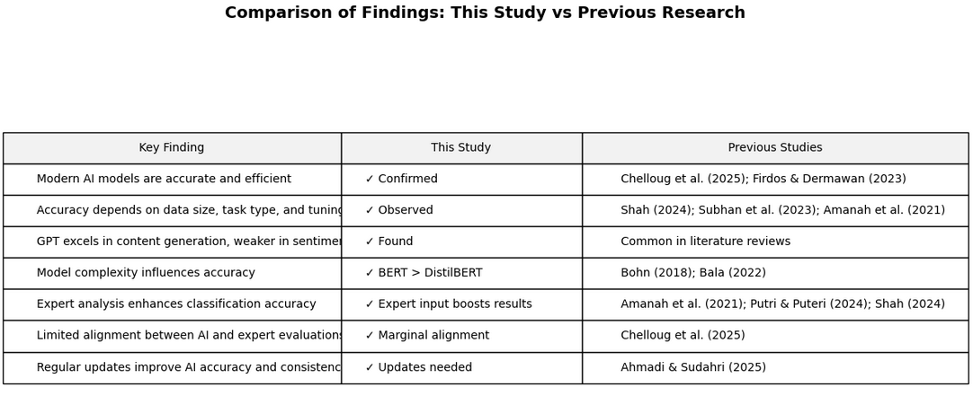
Comparison Summary: My Studies and Previous Studies

Slide 50
Comparison Analysis
Similarly to the above studies, this study established that
Pre-tained transformers like BERT and DistillBERT t are accurate on sentiment and text analysis
BERT is generally good than DistillBERT due reasons highlighted in the next slide, as established in literature analysis
Modern and robust models are accurate, precise, and efficient in text classification and sentiment tasks
The accuracy of the models improves with model complexity.
There is a marginal alignment between AI-based analyses and expert analysis.
The findings from AI-based analyses compare similar with previous studies

Slide 51
Roadblocks and Challenges
Data quality issues: Possible biases in translating multilingual comments
Computational cost: high-performance hardware is required for big data and real-time analysis
Ethical concerns: Model bias in analyzing neutral sentiments

Slide 52
Limitations
Big data analysis and classification due computational costs.
Platform is limited to diverse validation because it relies on restricted data only applicable to the platform.
Analyzing neutral comments
Real-time analysis and classification

Slide 53
Recommendations
Future projects to consider addressing issues of scalability by utilizing more advanced mechanisms and domain-specific embeddings
Future projects integrate real-time analysis and use pretrained models like GPT

Slide 54
Conclusions
Customer sentiments and feedback provide valuable insights to improve services, identify challenges, and address customer experience
AI-Driven analysis of pilgrim experiences (using pretrained transformers like BERT or GPT) provide smart data insights that significantly can enhance accurately, effective, and efficient Hajj and Umrah services

Slide 55
References
Publications on AI, text classification, and sentiment analysis
Previous studies on model accuracy
Resources and dataset utilized in this study

Slide 56
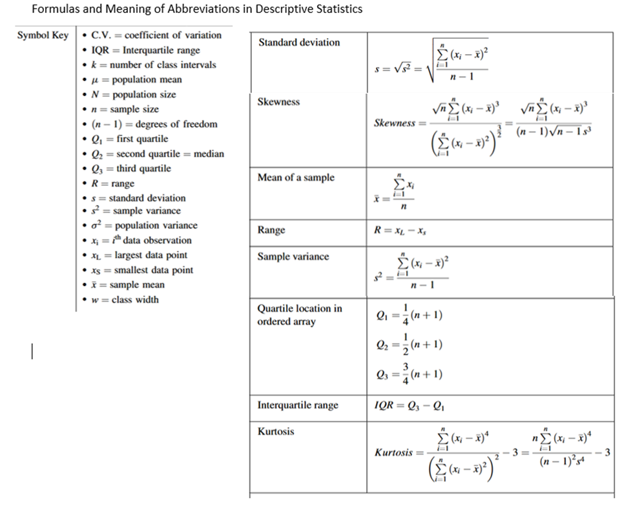
Appendix

Slide 57
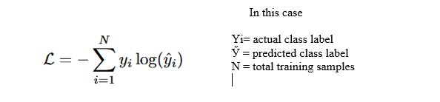
Cross-entropy Function For Model Optimization

